Slide 1

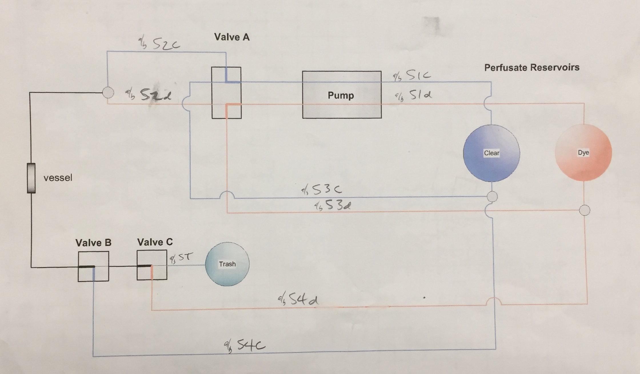
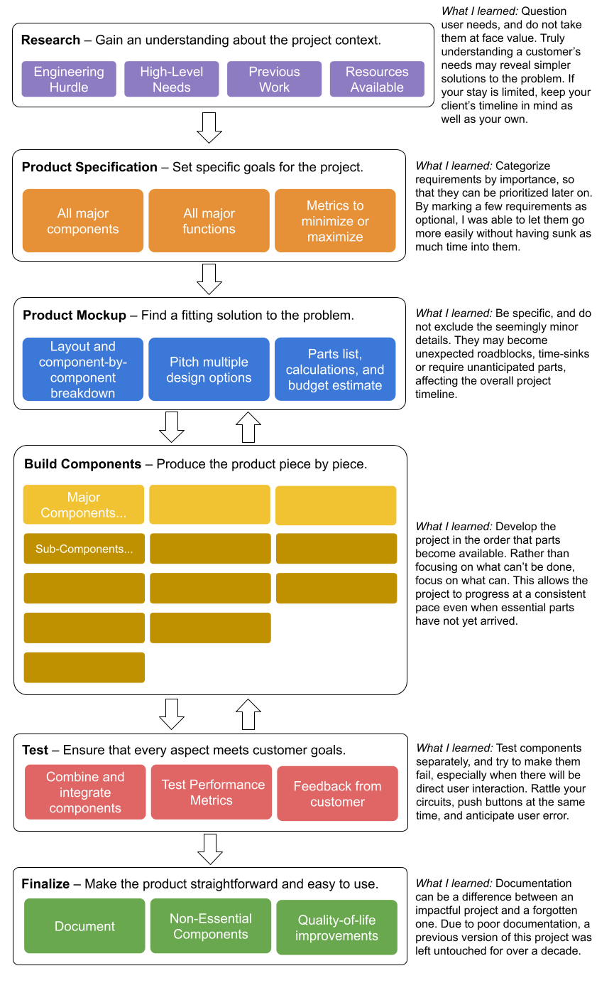
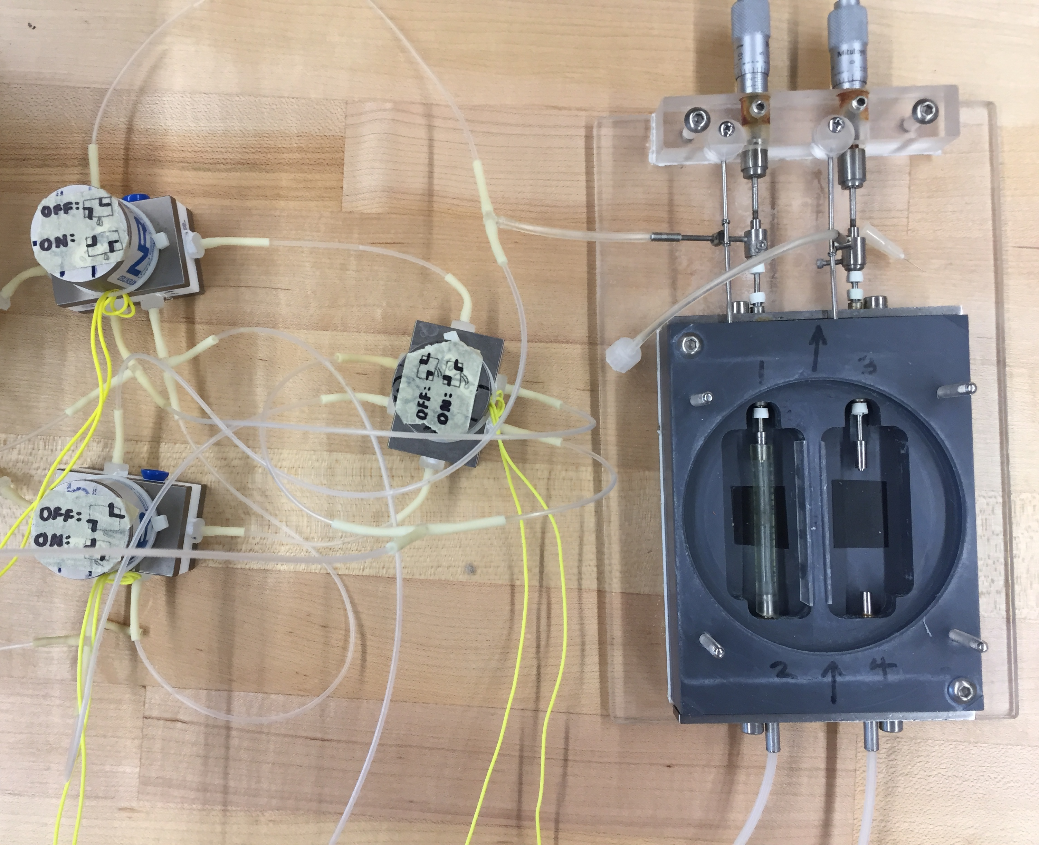
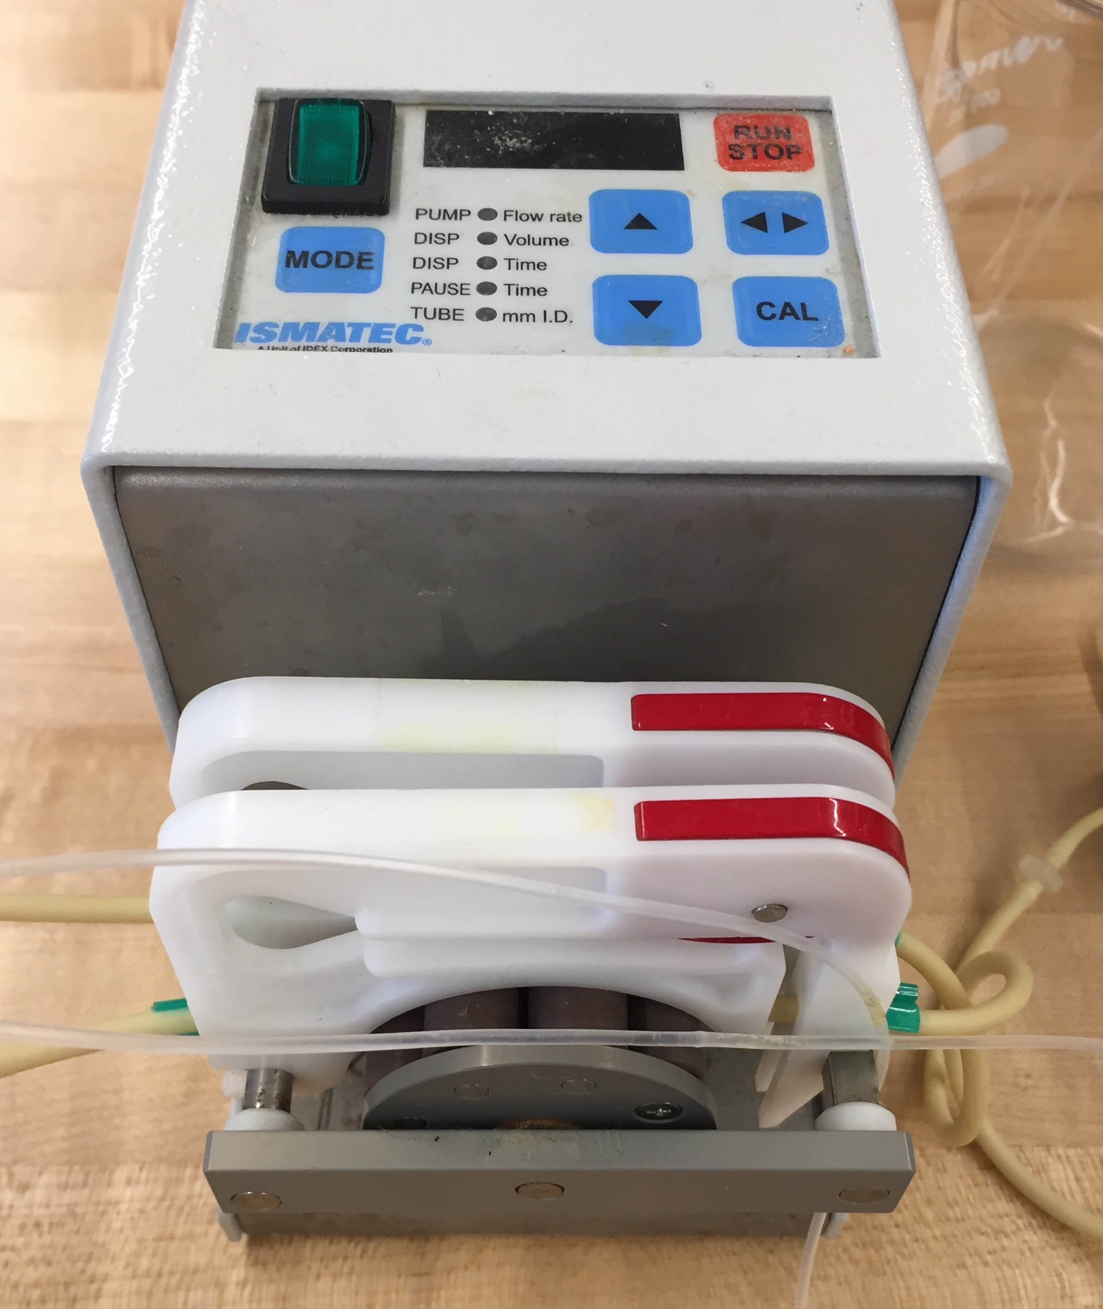
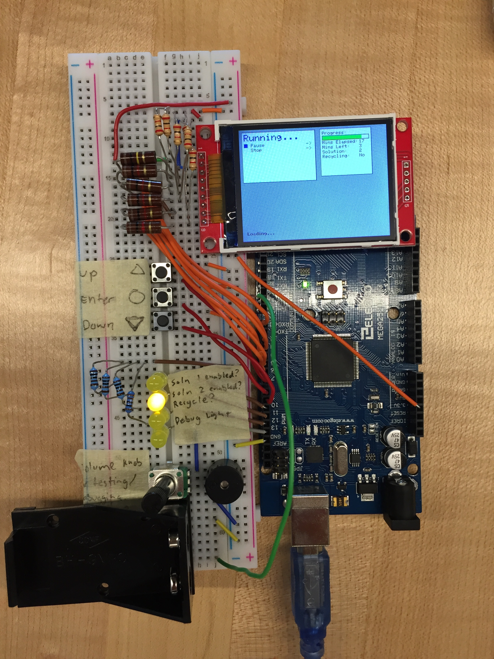
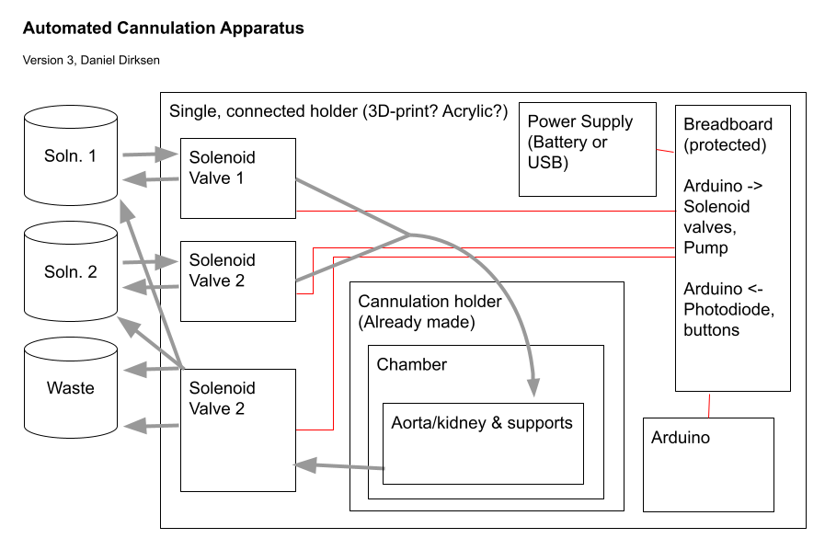
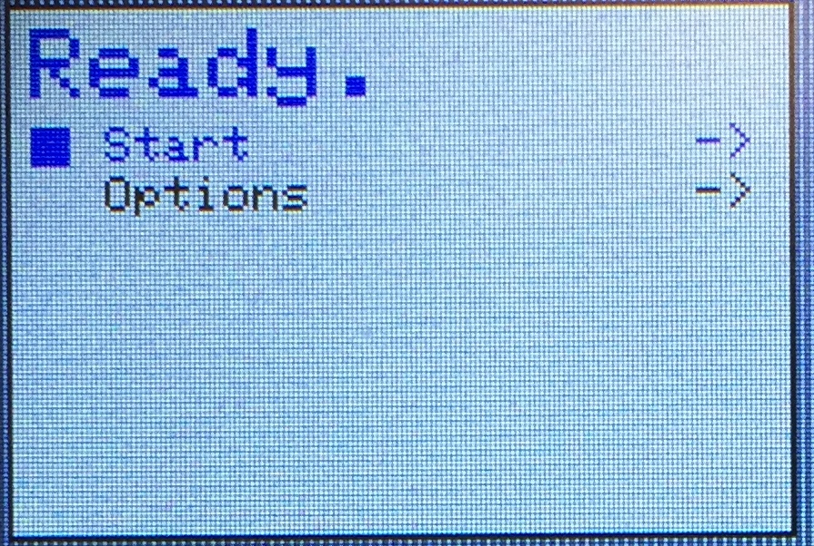
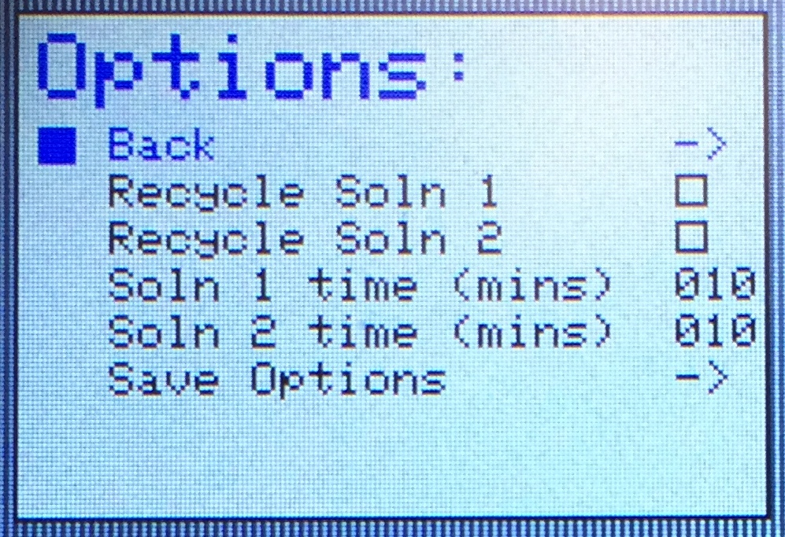
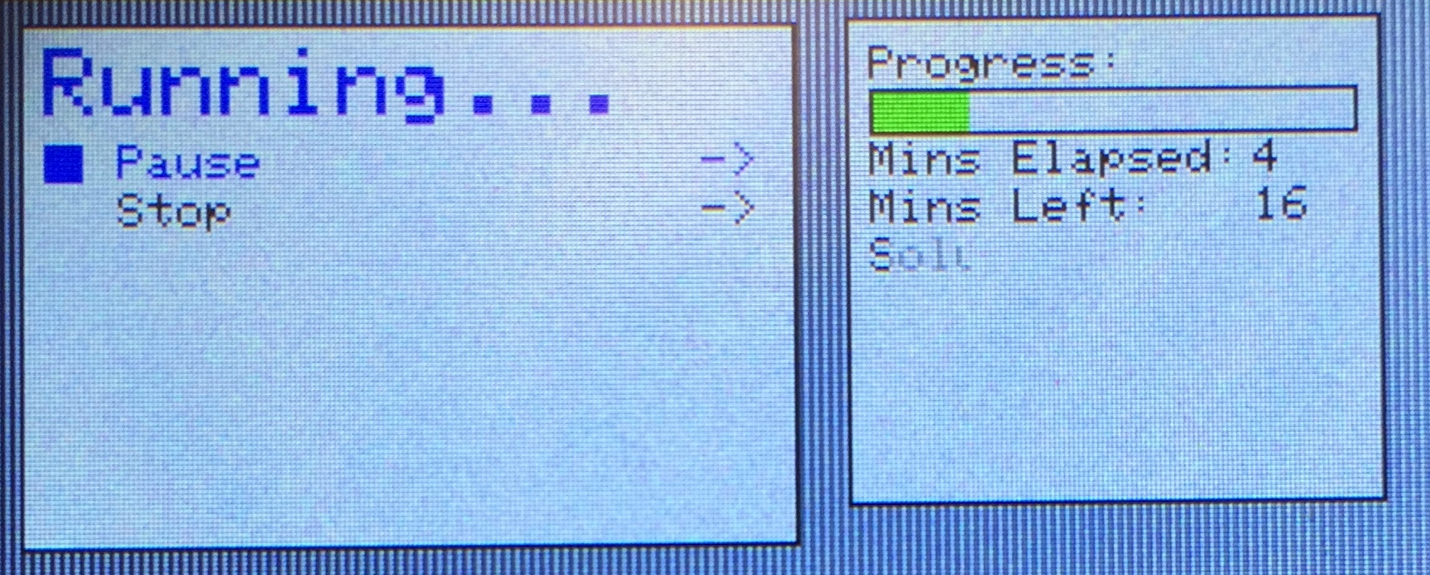
Automated Cannulation
Daniel Dirksen
Biola University | School of Science, Technology, and Health | SEI 2021
July 8th, 2021
Abstract
Previous work
The need for a specialized system to perform this experiment started two decades ago when Rutledge and his colleagues created a similar system to handle this problem. However, due to difficulty of use, lack of documentation, and changing research needs, the experiment was scrapped and its components were reused.
Results
Conclusions
The goal of this project was to create custom hardware that opens the door to new heart disease research to the Department of Biological Sciences. The machine operates like a configurable cappuccino machine, pumping two chemicals, one after the other, through the main blood vessel of a mouse or another specimen. A previous attempt at this machine has been made, but for decades it was unusable due to lack of documentation and changing research needs. In this project, a new system was designed with simplicity, consistency, and ease of use in mind. The project aimed to reduce systematic error, increase reproducibility, and lower standard deviation while being configurable enough to support a variety of experiments.
Dr. Kit Ng, the head researcher of this project, intends to use this machine to study heart disease, a major cause of death worldwide. For example, Dr. Ng will study how material can be built up or dislodged from the inner lining of arteries by high-density lipoproteins of various molecular sizes. This may shed some light on the underlying patterns behind the cause and prevention of heart disease on a molecular scale.
The system has three main parts, the tubing setup, the controller setup, and the interface.
Tubing Setup
A peristaltic pump moves two test solutions through their respective tubing and into the system. Because peristaltic pump functions independently from the apparatus, the tubing configuration was designed so that the pump can be left on even when the experiment is not running; pumped solutions will be automatically deposited back into their respective reservoirs without entering the chamber. The canulation takes place inside the grey chamber. The cannulation chamber is filled with a fluid and houses one mouse artery or another specimen. The two solutions are pushed through the specimen, one after the other, at a flow rate configured by the user. In the final step, the solution currently pumping through gets either recycled (deposited back into its origional container) or discarded, depending on a signal from the control module.
While the procedure it follows is simple, this system serves as a reliable research tool and enables the revival of research which started decades ago with Dr. John Rutledge. This project has been a multidisciplinary experience, requiring systems thinking and working on multiple levels of detail. It required communication, project management, planning, and a sense urgency in order to complete on fixed deadline.
Full Design Process
Background
Figure 1. Some documentation of previous work on the project from the early 2000s. Tubing layout differs significantly from the new design.
Key Concepts
Cannulation is the insertion of a thin tube into a blood vessel or another body cavity^{[1]}. Once this is done, chemicals can be pumped through in sequence. This operation has a variety of biomedical applications, both in research and in practice. It can be done in vivo (on a living subject, such as on a patient's arm) or in vitro (in isolation, such as on a mouse organ). The in vitro cannulation of mice is of interest to Dr. Kit Ng, who believes that this alternate way of cannulation may answer some questions about Coronary Artery Disease.
Caused by plaque buildup in the inner lining of the arteries [2], Coronary Artery Disease (CAD) is the most common form of heart disease and is a major cause of death, affecting about 6.7% of the population^{[3]}. The presence of plaque in the arteries can be measured using a biofluorescent, lipophilic dye called DiI, pronounced "Dye Aye"^{[4]}. It can be excited by a 545 nm light and will emit light at 555nm to be measured using specialized lenses and imaging.
Buildup can be dislodged from the arteries by a high-density lipoprotein (HDL) cholesterol^{[4]}. This "good" cholesterol takes many forms, differing greatly in properties such molecular size. It is known that different HDLs may be more or less active (more or less effective at removing buildup). However, the causes of these differences are not understood.
Research
One possible experiment using this system is to test how the size of HDL affects its performance. One solution, containing DiI, is pumped through the aorta (the largest artery) of a mouse for up to an hour. The solution sticks to and lines the aorta. Then a second solution, containing HDL, is pumped through the same way with the goal of remove the first solution. The remnants of the first solution in the aorta are measured using imaging, to quantify the effect of the HDL.
To do this experiment manually requires consistent timing and multitasking, from which arises the risk of systematic error, inconsistency, and expensive mistakes. With this system, however, and access to synthesized HDLs of varying properties, Dr. Ng and his interns can shed light on this disputed issue and demonstrate how these differences can be measured.
Objectives
To provide a simple, reproducible way to move two chemicals in series through a biological specimen.
To reduce systematic error, increase reproducibility, and lower standard deviation for future biological research.
To be user-friendly and easy for professors and interns to use.
To be flexible enough to serve as a base for a variety of experiments and specimens.
Figure 3. A working solenoid valve layout for tubing.
Figure 4. A peristaltic pump used to push both solutions through the experiment.
Materials and Parts
Controller Setup An Arduino MEGA controls the solenoid pumps in a predefined procedure configured by the user through the user interface. The Arduino sends a signal between 0 and 5 Volts on three wires. These connect to a four-way 12-Volt relay which amplifies the signal to 12 Volts, as required by the solenoid valves. It also displays a menu to the user on an SPI display module, allowing for the procedure to be controlled graphically. It takes input from three buttons, which are used to navigate the menu and manage the procedure.
Interface
Displayed on a TFT pixel display, a graphical user interface allows the user to start, stop, and configure the device. The user may configure the timing of the experiment and whether each solution is recycled or wasted. A state machine manages the interface navigation and updates the display only as necessary. The software is written in C++ using the Adafruit_ILI9341 Library. For future scalability, logic and content are separated. The source code can be found in the project's public GitHub repository:
https://github.com/wwwiop/cannulation-project
Arduino MEGA 2560
(3) NResearch 12V DC 30 PSI Solenoid Valves. P/N: 360T041
Generic breadboard, wiring, LEDs, buttons, resistors, active buzzer
2.2 TFT SPI 240x320 pixel display
(3) 1N4004 Snuffer Diodes
ISMATEC Peristaltic pump with two cassettes
Generic waterproof tubing
12V AC to DC Power Supply Module
NOYITO 4-Channel 12V Relay Module
(Future) 3d-Printed PLA Casing
Figure 7. This is an abstract overview of an approach to engineering which has been both demonstrated and developed by this 8-week project. It reveals the problem-solving approach to a single-person engineering task as well as the lessons learned throughout the design process.
Figure 5. The wiring of the system, with placeholder LEDs indicating the control unit’s output signals to the various solenoid valves.
References
Layout
"cannulate, v." OED Online. Oxford University Press, June 2021. Web. 29 June 2021.
“Coronary Artery Disease.” Centers for Disease Control and Prevention, Centers for Disease Control and Prevention, 9 Dec. 2019, www.cdc.gov/heartdisease/coronary_ad.htm.
Centers for Disease Control and Prevention. (2019, December 9). Coronary Artery Disease. Centers for Disease Control and Prevention. https://www.cdc.gov/heartdisease/coronary_ad.htm.
J.C. Rutledge et. al. Direct Visualization of Lipid Deposition and Reverse Lipid Transport in a perfused Artery, 2000
Figure 6. A few example pages in the user interface. A large blank space is left under the menu screen for documentation, as shown in figure 5.
Acknowledgements
Dr. Elaine Wong, Faculty at CPE Department, Biola University. SEI 2021 Mentor.
Stanley Ng, Chair of CPE Department, Biola University. SEI 2021 Mentor.
Dr. Kit Ng, Department of Biological Sciences, Biola University. Head of the project.
Dr. John Rutledge, Vice Chair of Research, U.C. Davis. Pioneered the visualization of LDL, adhesion to blood vessels.
Figure 2. The overall layout of the system. Grey arrows represent the flow of liquids, while red lines indicate elements which are electrically connected.

